Slide 1
MA3077 (DLI) Operational Research Lecture 2 – Linear programming
Dr Neslihan Suzen

Slide 2
Lecture Outline
Today's goal is to:
introduce the concepts of optimisation and linear programming,
learn how to solve linear programming problems using a graphical method,
learn how to write a linear programming problem in standard form,
and learn how some nonlinear functions can be modeled in a linear fashion.
Today's lecture is loosely based on chapters 2.1 and 2.2 of the Mosek Cookbook.

Slide 3
What is optimisation?
Optimisation is a technique to determine the best possible solution to a given problem.
This is done by first formulating a problem in mathematical terms, and then by applying suitable optimisation algorithms.
Formulating the problem in mathematical terms can be challenging. Coding it up can also require some skills.

Slide 4
Optimisation – key terms
To formulate the mathematical model, one must first identify:
the objective: a function that describes how "optimal" a configuration is, and that you aim to maximise or minimise (e.g.: profit, cost, production,...)
the control/decision variables: what you can modify to maximise/minimise the objective function (e.g.: resource allocation, ...)
the constraints: the conditions that that the control variable must satisfy (eg: time and resource constraints, ...)

Slide 5
A trivial example – problem statement
You have £15 and you want to purchase as much flour as possible to bake delicious bread.
Your local supermarket sales loose flour at £1 per kg.
How many kg of flour will you buy?

Slide 6
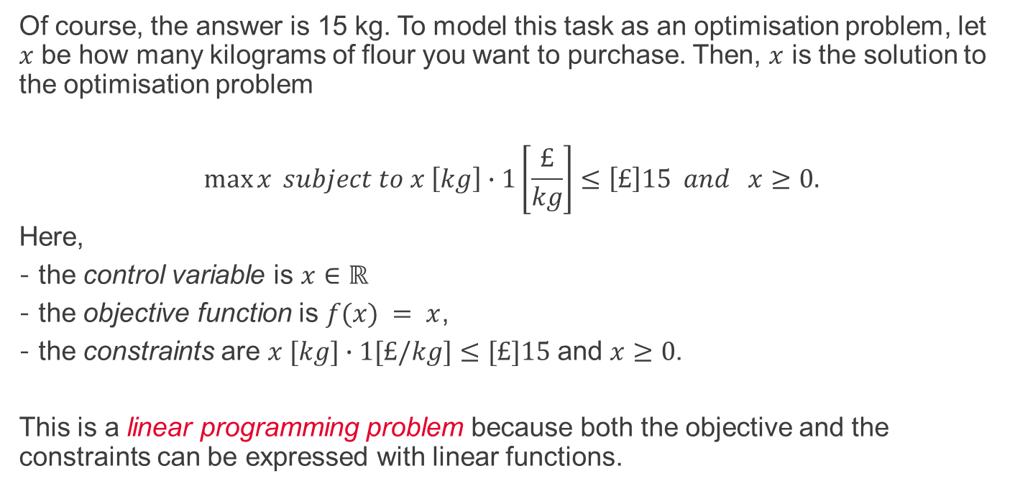
A trivial example – mathematical model
Of course, the answer is 15 kg. To model this task as an optimisation problem, let $x$ be how many kilograms of flour you want to purchase. Then, $x$ is the solution to the optimisation problem
$$\max{x} subject to x \left[kg\right]∙1\left[\frac{£}{kg}\right]≤\left[£\right]15 and x≥0.$$
Here,
the control variable is $x∈ℝ$
the objective function is $f(x) = x$,
the constraints are $x [kg]∙1[£/kg]≤[£]15$ and $x≥0$.
This is a linear programming problem because both the objective and the constraints can be expressed with linear functions.

Slide 7
An example – problem statement
Description: A chemical plant produces two compounds (compound A and B).
Producing 1 kg of compound A requires 1 kg of raw material and 8 processing hours, whereas 1 kg of compound B requires 2 kg of raw material and 7 processing hours.
Compound A can be sold at £80 per kg, whereas compound B at £120 per kg.
The market can absorb at most 3 kg of compound A.
The chemical plant currently owns 6 kg of raw material and has 28 processing hours available.
Question: How many kilograms of each compound should the plant produce to maximise the revenue?

Slide 8
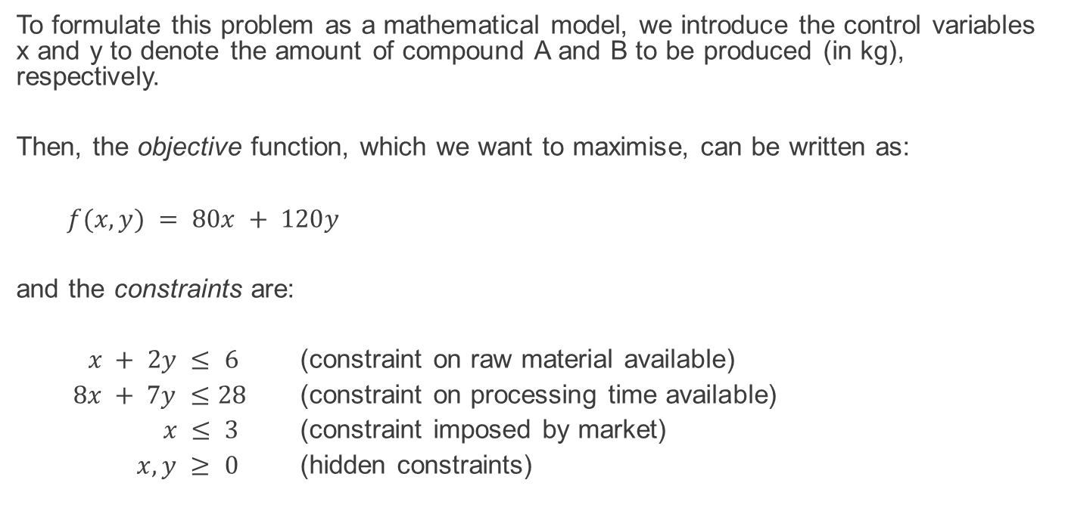
An example – mathematical formulation 1/2
To formulate this problem as a mathematical model, we introduce the control variables x and y to denote the amount of compound A and B to be produced (in kg), respectively.
Then, the objective function, which we want to maximise, can be written as:
$$f(x,y) = 80x + 120y$$
and the constraints are:
$x + 2y ≤ 6$ (constraint on raw material available)
$8x + 7y ≤28$ (constraint on processing time available)
$x ≤ 3$ (constraint imposed by market)
$x, y ≥ 0$ (hidden constraints)

Slide 9
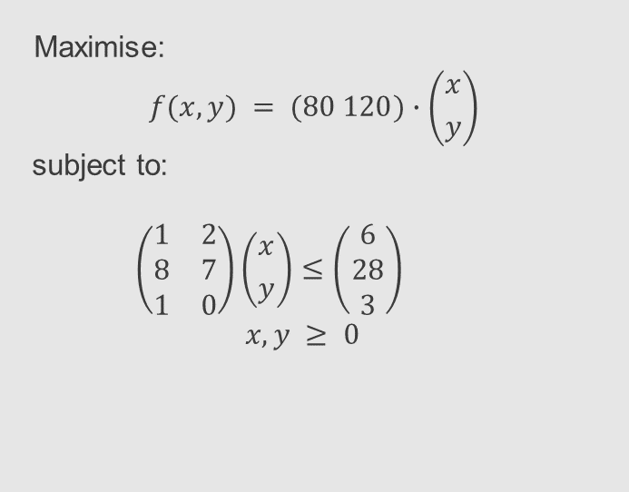
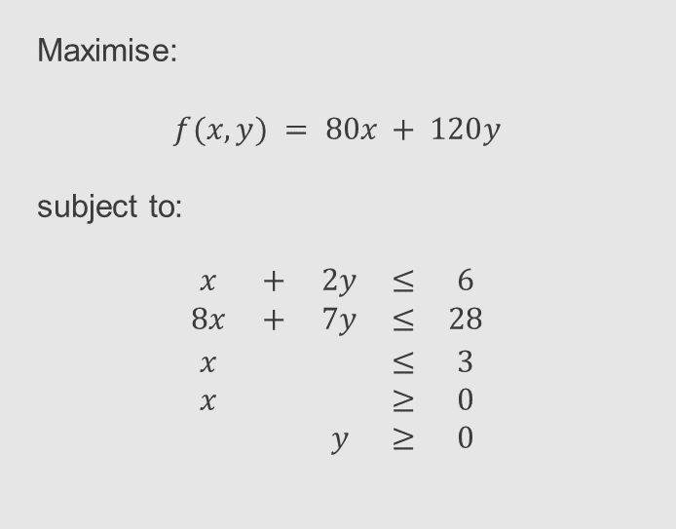
An example – mathematical formulation 2/2
Mathematically, we usually write the problem more compactly as shown in the right column.
Maximise:
$$f(x,y) = 80x + 120y$$
subject to:
$$\begin{matrix}x & + & 2y & ≤ & 6 \\ 8x & + & 7y & ≤ & 28 \\ x & & & ≤ & 3 \\ x & & & ≥ & 0 \\ & & y & ≥ & 0\end{matrix}$$
Maximise:
$$f(x,y) = (80 120)∙\left({x \atop y}\right)$$
subject to:
$$\left(\begin{matrix}1 & 2 \\ 8 & 7 \\ 1 & 0\end{matrix}\right)\left({x \atop y}\right)≤\left(\begin{matrix}6 \\ 28 \\ 3\end{matrix}\right)$$
$$x,y ≥ 0$$
This is a linear programming problem because both the objective and the constraints can be expressed with linear functions.

Slide 10
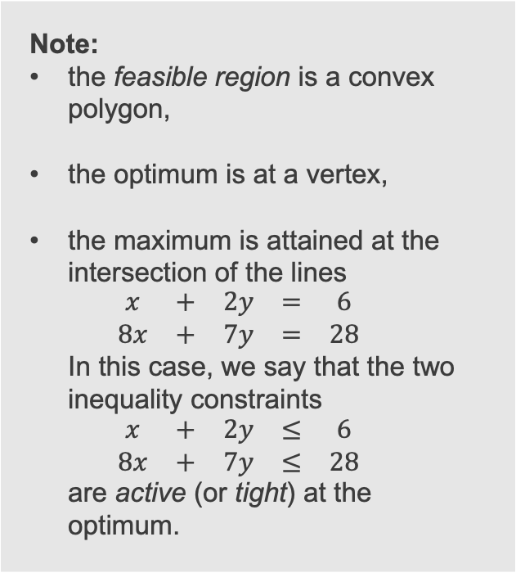
An example – graphical solution (with Matlab) (with Matlab see OR01_feasible_region.m)
Note:
the feasible region is a convex polygon,
the optimum is at a vertex,
the maximum is attained at the intersection of the lines $\begin{matrix}x & + & 2y & = & 6 \\ 8x & + & 7y & = & 28\end{matrix}$ In this case, we say that the two inequality constraints $\begin{matrix}x & + & 2y & ≤ & 6 \\ 8x & + & 7y & ≤ & 28\end{matrix}$ are active (or tight) at the optimum.

Slide 11
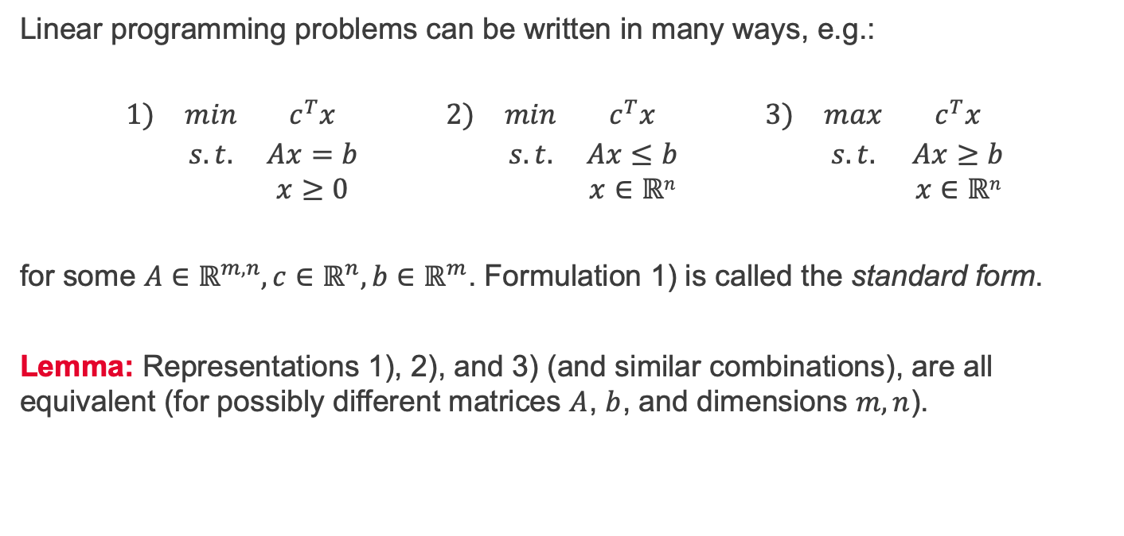
Linear programming in standard form
Linear programming problems can be written in many ways, e.g.:
$$\begin{matrix}1) & min & c^{T}x & & 2) & min & c^{T}x & & 3) & max & c^{T}x \\ & s.t. & Ax=b & & & s.t. & Ax≤b & & & s.t. & Ax≥b \\ & & x≥0 & & & & x∈ℝn & & & & x∈ℝn\end{matrix}$$
for some $A∈ℝ^{m,n}, c∈ℝ^{n}, b∈ℝ^{m}$. Formulation 1) is called the standard form.
Lemma: Representations 1), 2), and 3) (and similar combinations), are all equivalent (for possibly different matrices $A$, $b$, and dimensions $m,n$).

Slide 12
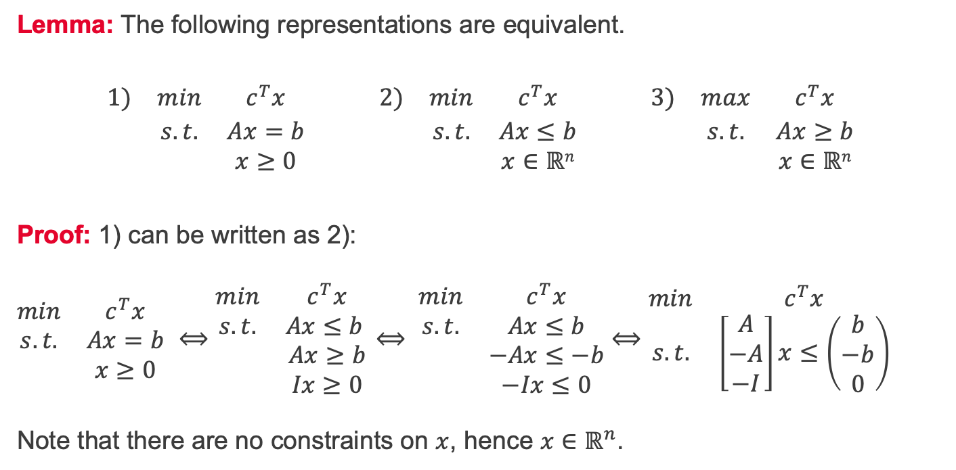
Linear programming in standard form – Proof 1/3
Lemma: The following representations are equivalent.
$$\begin{matrix}1) & min & c^{T}x & & 2) & min & c^{T}x & & 3) & max & c^{T}x \\ & s.t. & Ax=b & & & s.t. & Ax≤b & & & s.t. & Ax≥b \\ & & x≥0 & & & & x∈ℝn & & & & x∈ℝn\end{matrix}$$
Proof: 1) can be written as 2): $\begin{matrix}min & c^{T}x \\ s.t. & Ax=b \\ & x≥0\end{matrix}$ $⟺\begin{matrix}min & c^{T}x \\ s.t. & Ax≤b \\ & Ax≥b \\ & Ix≥0\end{matrix}$ $⟺ \begin{matrix}min & c^{T}x \\ s.t. & Ax≤b \\ & −Ax≤−b \\ & −Ix≤0\end{matrix}$ $⟺$ $\begin{matrix}min & c^{T}x \\ s.t. & \left[\begin{matrix}A \\ −A \\ −I\end{matrix}\right]x≤\left(\begin{matrix}b \\ −b \\ 0\end{matrix}\right)\end{matrix}$ Note that there are no constraints on $x$, hence $x∈ℝ^{n}$.

Slide 13
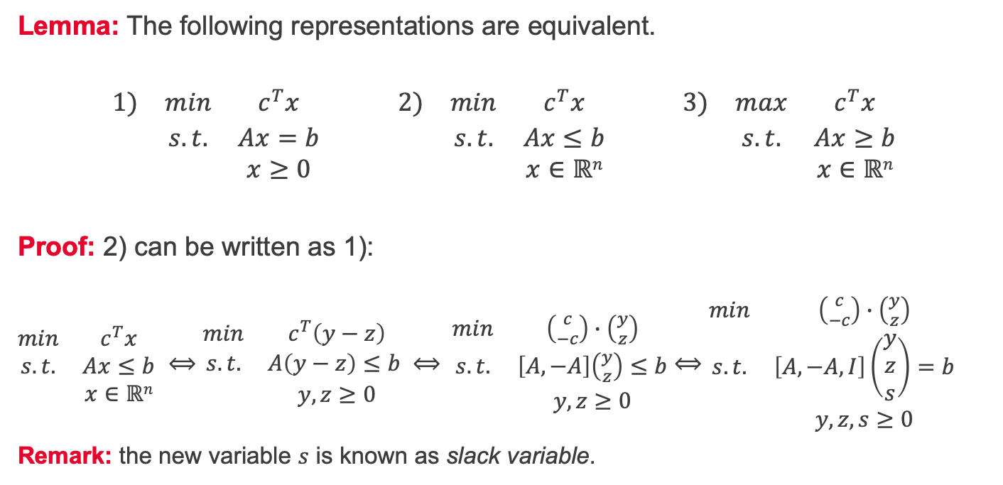
Linear programming in standard form – Proof 2/3
Lemma: The following representations are equivalent.
$$\begin{matrix}1) & min & c^{T}x & & 2) & min & c^{T}x & & 3) & max & c^{T}x \\ & s.t. & Ax=b & & & s.t. & Ax≤b & & & s.t. & Ax≥b \\ & & x≥0 & & & & x∈ℝn & & & & x∈ℝn\end{matrix}$$
Proof: 2) can be written as 1): $\begin{matrix}min & c^{T}x \\ s.t. & Ax≤b \\ & x∈ℝn\end{matrix}$ $⟺\begin{matrix}min & c^{T}\left(y−z\right) \\ s.t. & A\left(y−z\right)≤b \\ & y, z≥0\end{matrix}$ $⟺ \begin{matrix}min & \left({c \atop −c}\right)∙\left({y \atop z}\right) \\ s.t. & \left[A, −A\right]\left({y \atop z}\right)≤b \\ & y, z≥0\end{matrix}$ $⟺\begin{matrix}min & \left({c \atop −c}\right)∙\left({y \atop z}\right) \\ s.t. & \left[A, −A, I\right]\left(\begin{matrix}y \\ z \\ s\end{matrix}\right)=b \\ & y, z,s≥0\end{matrix}$
Remark: the new variable $s$ is known as slack variable.

Slide 14
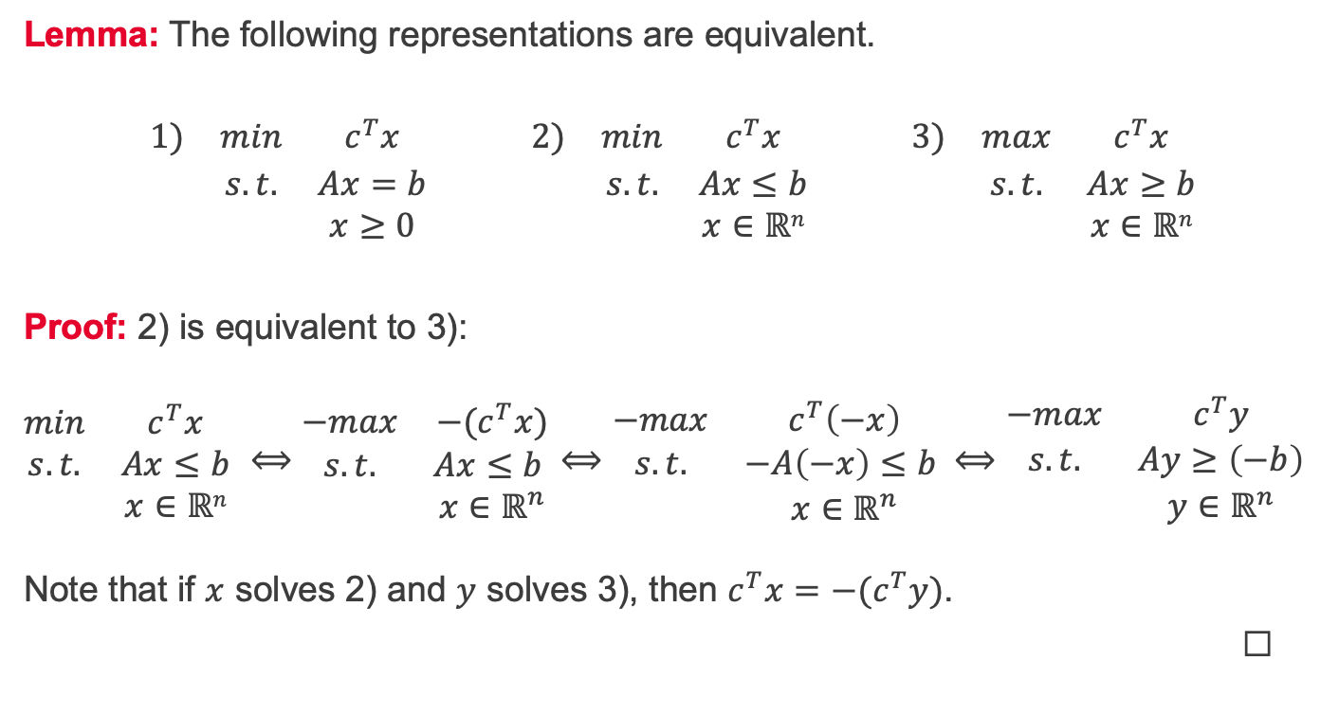
Linear programming in standard form – Proof 3/3
Lemma: The following representations are equivalent.
$$\begin{matrix}1) & min & c^{T}x & & 2) & min & c^{T}x & & 3) & max & c^{T}x \\ & s.t. & Ax=b & & & s.t. & Ax≤b & & & s.t. & Ax≥b \\ & & x≥0 & & & & x∈ℝn & & & & x∈ℝn\end{matrix}$$
Proof: 2) is equivalent to 3): $\begin{matrix}min & c^{T}x \\ s.t. & Ax≤b \\ & x∈ℝn\end{matrix}$ $⟺\begin{matrix}−max & {−(c}^{T}x) \\ s.t. & Ax≤b \\ & x∈ℝ^{n}\end{matrix}$ $⟺\begin{matrix}−max & c^{T}\left(−x\right) \\ s.t. & −A\left(−x\right)≤b \\ & x∈ℝ^{n}\end{matrix}⟺\begin{matrix}−max & c^{T}y \\ s.t. & Ay≥\left(−b\right) \\ & y∈ℝ^{n}\end{matrix}$ Note that if $x$ solves 2) and $y$ solves 3), then $c^{T}x=−(c^{T}y)$.
☐

Slide 15
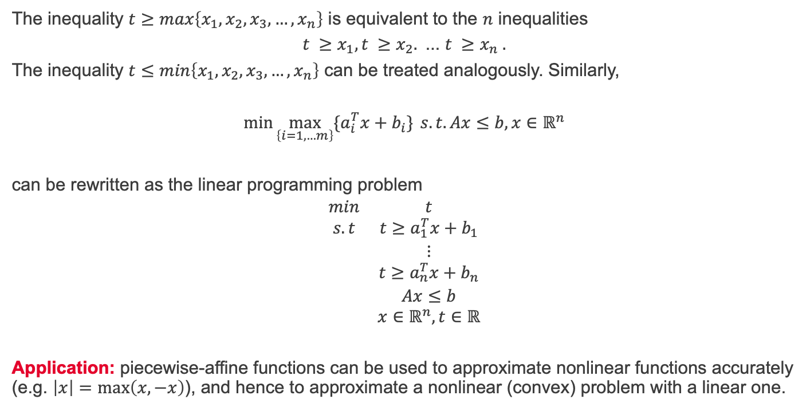
Linear modelling - maximum
The inequality $t≥max\left\{x_{1},x_{2},x_{3},…,x_{n}\right\}$ is equivalent to the $n$ inequalities
$$t ≥x_{1},t ≥x_{2}.\text{ ... }t ≥x_{n} .$$
The inequality $t≤min\left\{x_{1},x_{2},x_{3},…,x_{n}\right\}$ can be treated analogously. Similarly,
$$\min{\max_{\left\{i=1,…m\right\}}{{\{a}_{i}^{T}x+b_{i}\}}} s.t.Ax≤b, x∈ℝ^{n}$$
can be rewritten as the linear programming problem
$$\begin{matrix}min & t \\ s.t & t≥a_{1}^{T}x+b_{1} \\ & ⋮ \\ & t≥a_{n}^{T}x+b_{n} \\ & Ax≤b \\ & x∈ℝ^{n}, t∈ℝ\end{matrix}$$
Application: piecewise-affine functions can be used to approximate nonlinear functions accurately (e.g. $\left|x\right|=\max\left(x, −x\right)$), and hence to approximate a nonlinear (convex) problem with a linear one.

Slide 16
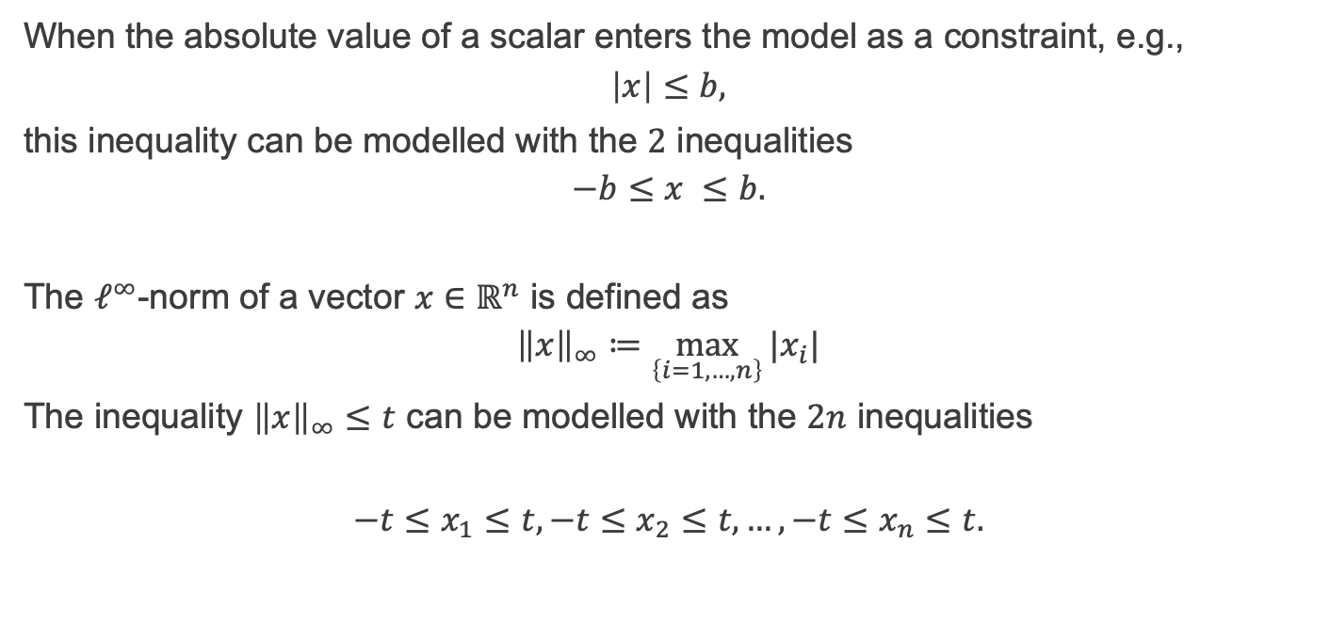
Linear modelling – absolute value and $ℓ^{∞}$-norm
When the absolute value of a scalar enters the model as a constraint, e.g.,
$$\left|x\right|≤b,$$
this inequality can be modelled with the $2$ inequalities
$$−b≤x ≤b.$$
The $ℓ^{∞}$-norm of a vector $x∈ℝ^{n}$ is defined as
$${\left\|x\right\|}_{∞}≔\max_{\left\{i=1, …, n\right\}}{|x_{i}|}$$
The inequality ${\left\|x\right\|}_{∞}≤t$ can be modelled with the $2n$ inequalities
$$−t≤x_{1}≤t,−t≤x_{2}≤t,…,−t≤x_{n}≤t.$$

Slide 17
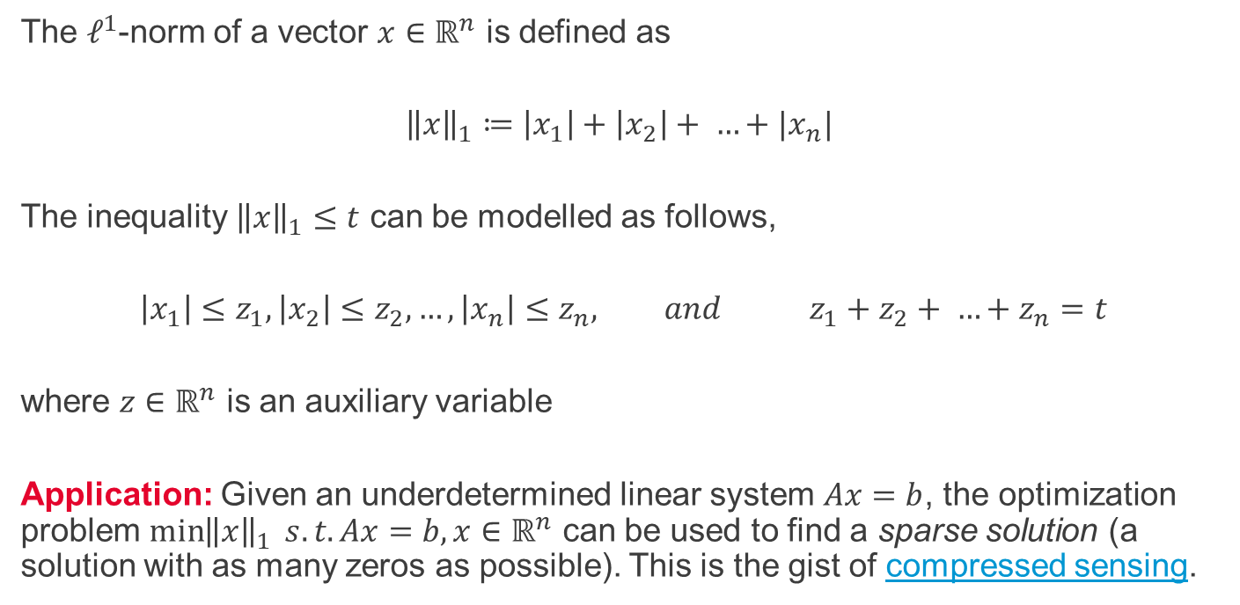
Linear modelling - $ℓ^{1}$-norm
The $ℓ^{1}$-norm of a vector $x∈ℝ^{n}$ is defined as
$${\left\|x\right\|}_{1}≔\left|x_{1}\right|+\left|x_{2}\right|+ …+|x_{n}|$$
The inequality ${\left\|x\right\|}_{1}≤t$ can be modelled as follows,
$$\left|x_{1}\right|≤z_{1},\left|x_{2}\right|≤z_{2},…,\left|x_{n}\right|≤z_{n}, and { z}_{1}+z_{2}+ …+z_{n}=t$$
where $z∈ℝ^{n}$ is an auxiliary variable
Application: Given an underdetermined linear system $Ax=b$, the optimization problem $\min{{\left\|x\right\|}_{1}} s.t.Ax=b,x∈ℝ^{n}$ can be used to find a sparse solution (a solution with as many zeros as possible). This is the gist of compressed sensing.

Slide 18
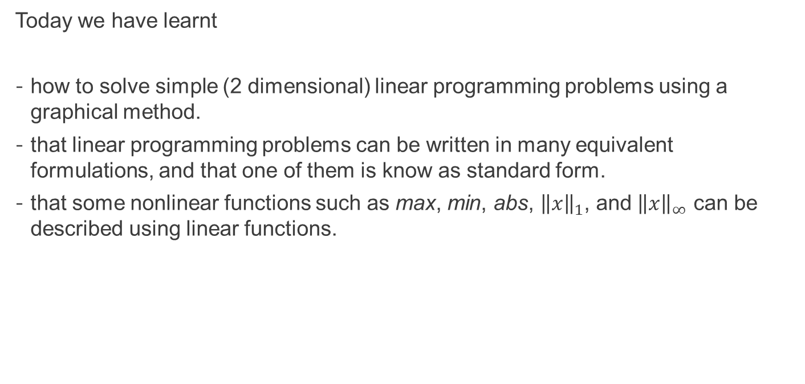
Summary
Today we have learnt
how to solve simple (2 dimensional) linear programming problems using a graphical method.
that linear programming problems can be written in many equivalent formulations, and that one of them is know as standard form.
that some nonlinear functions such as max, min, abs, ${\left\|x\right\|}_{1}$, and ${\left\|x\right\|}_{∞}$ can be described using linear functions.

Slide 19
Self-study
A farmer owns 80 acres and produces wheat and barley. To produce these crops, the farmer incurs some costs (seeds, fertilizers, etc.). An acre of wheat costs £100, whereas an acre of barley costs £120. To sell the crops at the most favorable market conditions (£1.50 per bushel of wheat and £3.00 per bushel of barley), the farmer stores them in a barn that has capacity for 5'000 bushels. An acre cultivated with wheat produces 115 bushels, whereas an acre allocated to barley produces 35 bushels. Knowing that the farmer currently has £16'000 available for expenses, how should they plant their field?
Create your own (2 dimensional) linear programming problem and solve it using the graphical method. Then, write your example in standard form.

